Slide 1
Covid-19 Socio-Economic Impact Case Study of Senegal Pr Latif Dramani | CREG 2020

Slide 2
Outline
Background
Covid-19 Situation in Africa
Covid-19 channels & SDGs
Covid-19 Socio economic Impact
NTA framework classics & Extension
Data & Hypotheses source
Scenarii description (Optimistic to pessimistic)
Results on Senegal Study Case
Covid-19 Impact on Support Ratio & DD
Covid-19 Impact on Social dimensions
Next Steps

Slide 4
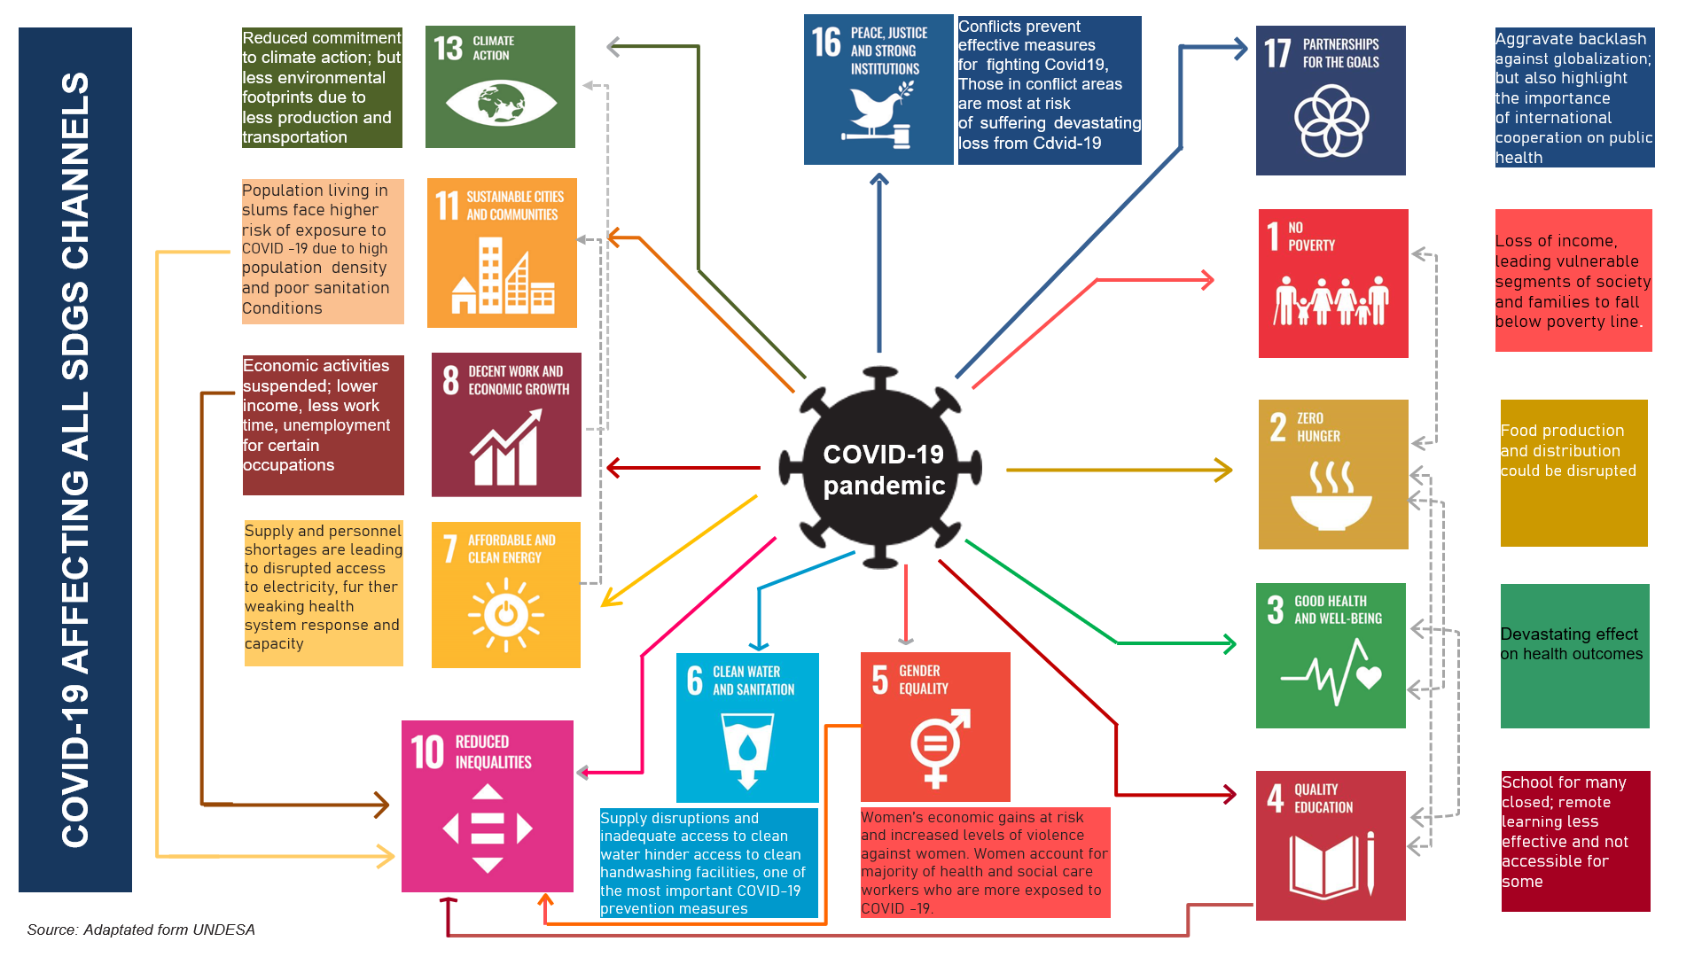

Slide 5
» » » Covid-19 SOCIOECONOMIC IMPACT nta framework ⦀ data sources ⦀ scenarii description

Slide 11
h »»»» Senegal case study RESULTS Support ratio & dd ⦀ Social Dimensions

Slide 15
THANKS…MERCI

